Slide 1
R-Ladies Munich Second meetup News June 2017
library(dplyr)
rladies_global %>%
filter(city == 'Munich')

Slide 2
1. Awesome things R-Ladies are doing around the world!

Slide 3


Slide 4
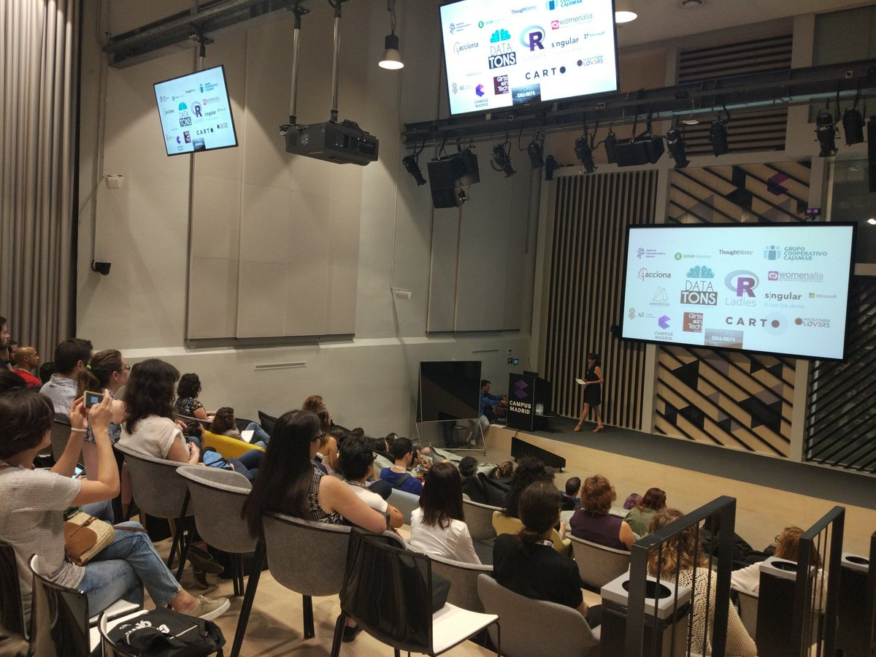
Call of Data: R-Ladies Madrid
When? 03.06.2017
Where? Madrid
Webpage: http://www.callofdata.info/

Slide 5
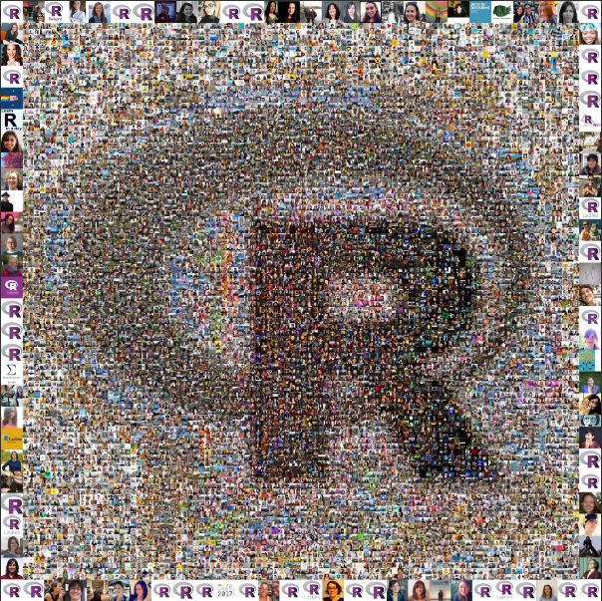

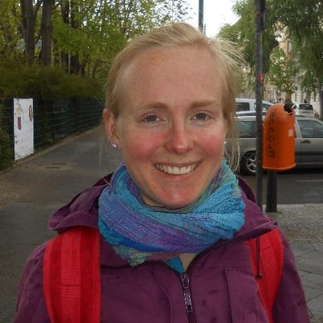
The faces of R-Ladies by Lucy McGowan and Maëlle Salmon

Slide 6
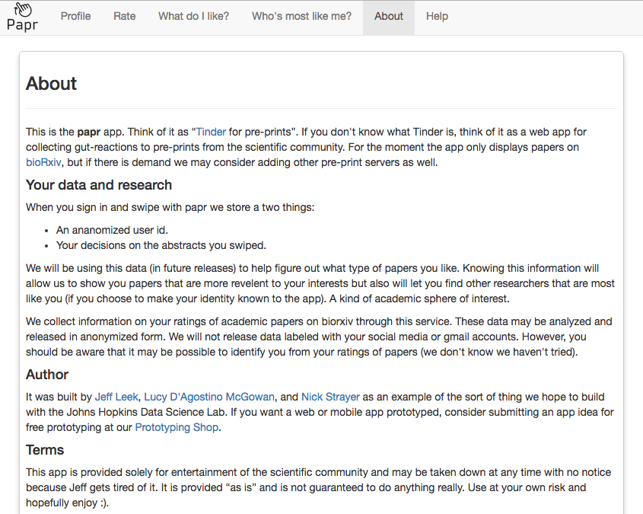
Papr: Tinder for preprints https://jhubiostatistics.shinyapps.io/papr/

Slide 7
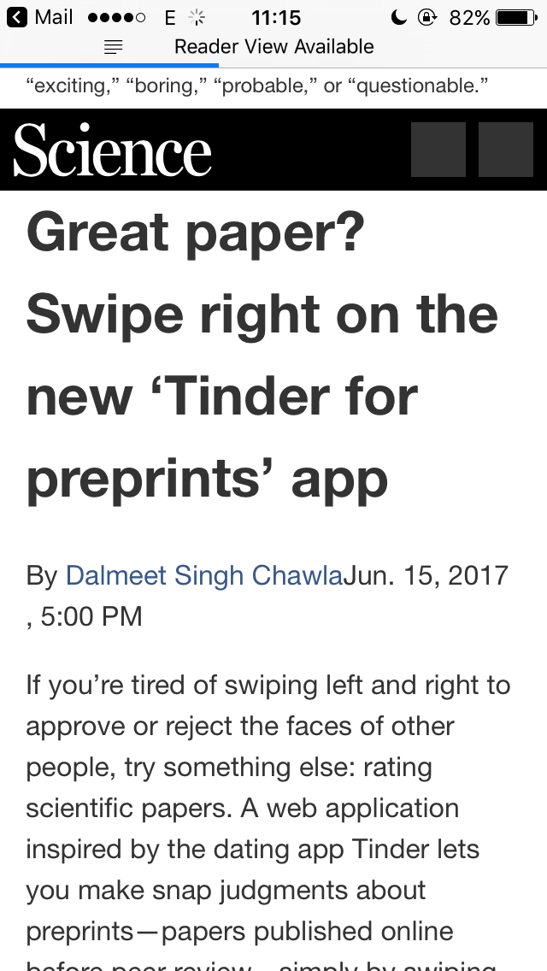
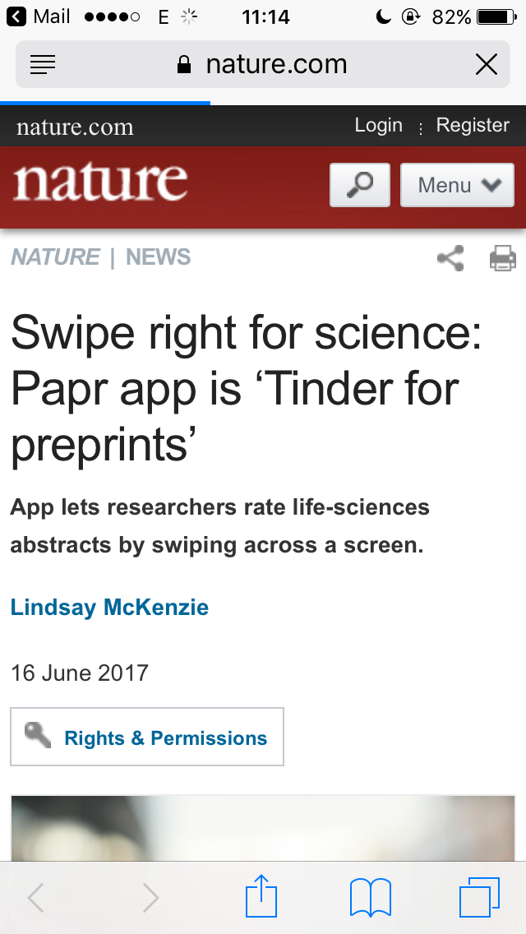
Papr: Tinder for preprints https://jhubiostatistics.shinyapps.io/papr/

Slide 8
2. Conferences PAST Conferences

Slide 9
Runconf2017
Who? rOpenSci
When? 25-26.05.2017
Where? Los Angeles, CA
Twitter: #runconf17
Webpage: http://unconf17.ropensci.org/
Projects: https://ropenscilabs.github.io/runconf17-projects/

Slide 10
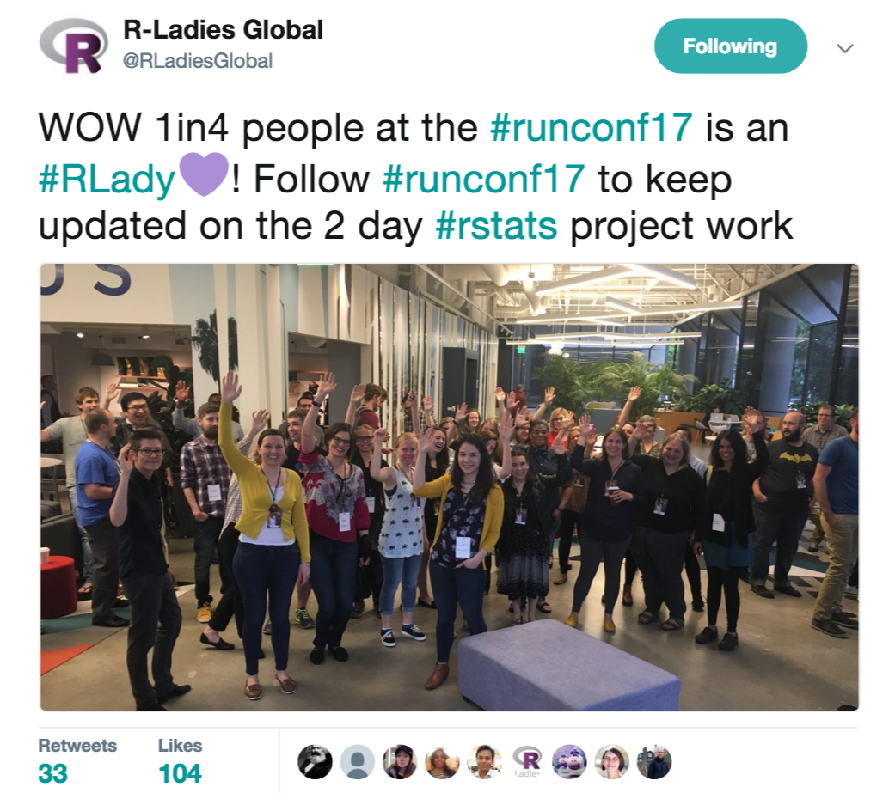

Slide 11
EARL SF 2017 Enterprise Applications of the R Language
When? 05-07.06.2017
Where? San Francisco, CA
Twitter: #EARLConf2017
Webpage: https://earlconf.com/sanfrancisco/

Slide 12
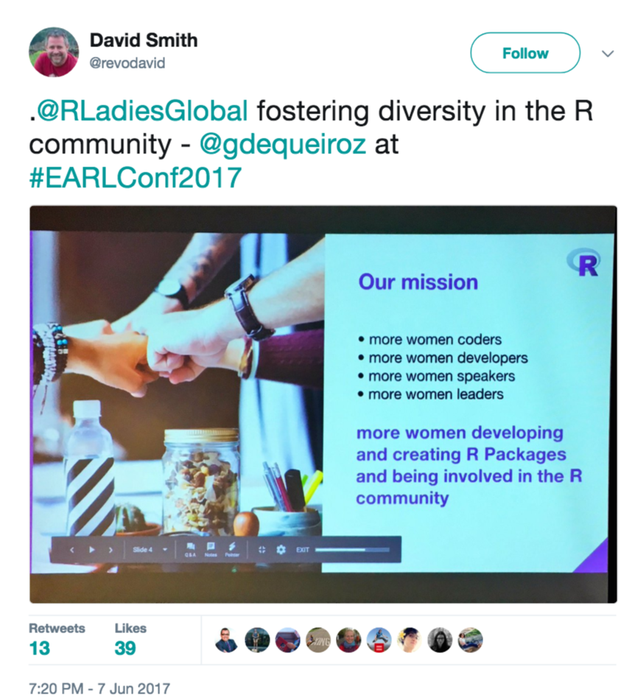

Slide 13
2. Conferences UPCOMING Conferences

Slide 14
useR!2017
When? 04-07.07.2017
Where? Brussels, Belgium
Webpage: https://user2017.brussels/
EARL 2017 London
When? 12-14.09.2017
Where? London, UK
Webpage: https://earlconf.com/london/

Slide 15
Women in Statistics and Data Science
Who? American Statistical Association
When? 19-21.10.2017
Where? La Jolla, CA
Webpage: https://ww2.amstat.org/meetings/wsds/2017/index.cfm

Slide 16
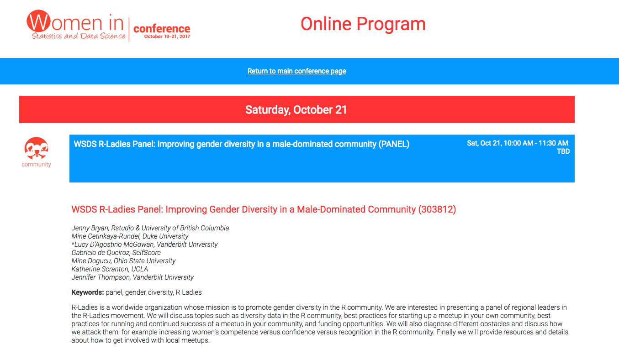
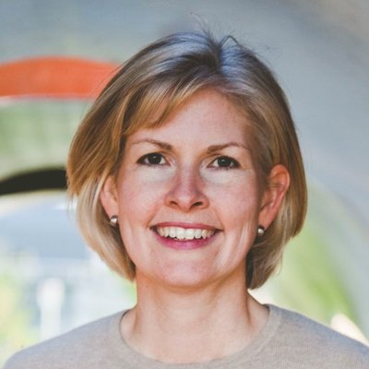
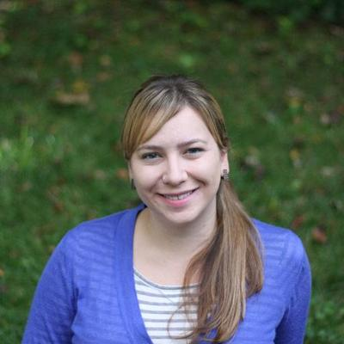
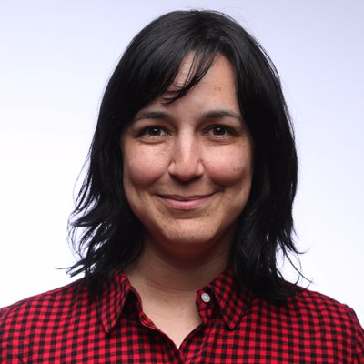
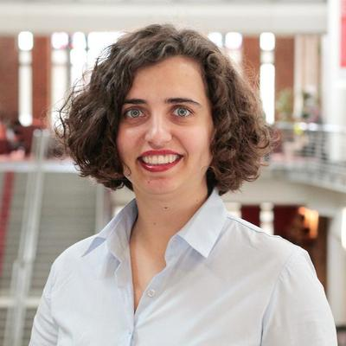

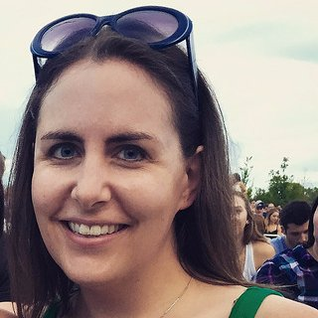
Notes:
Jenny: Rstudio
Mine Cetinkaya-Rundel: Durham
Mine Dogocu: Columbus
Lucy: Nashville
Gabriela: Founder, SF
Katherine: Los Angeles
Jennifer Thompson: Nashville

Slide 17
3. R-Ladies Munich Slack

Slide 18
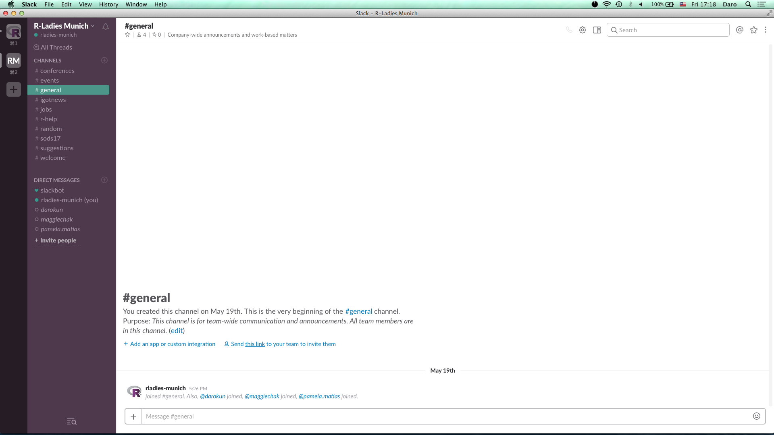
Go to https://rladies-munich.slack.com/
and sign up!

Slide 19
4. Summer of Data Science 2017 #SoDS17

Slide 20
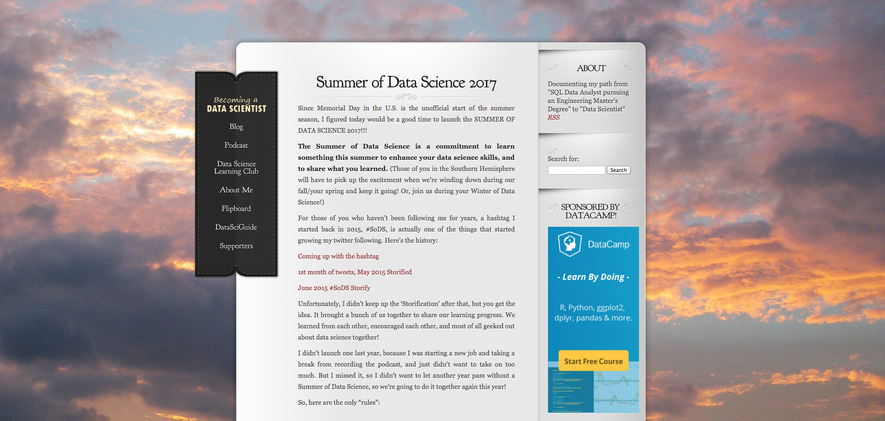
https://www.becomingadatascientist.com/2017/05/29/summer-of-data-science-2017/
Notes:
Renee M. P. Teate

Slide 21
How to participate in the #SoDS17
Pick a thing or a short list of things related to data science that you want to learn more about this summer.
Make a plan to learn it (like an online course, a practice project, etc.).
Share that plan on social media, then post updates as you make progress, with the hashtag #SoDS17.

Slide 22
4. Swirl

Slide 23

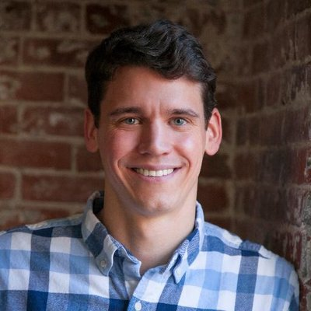
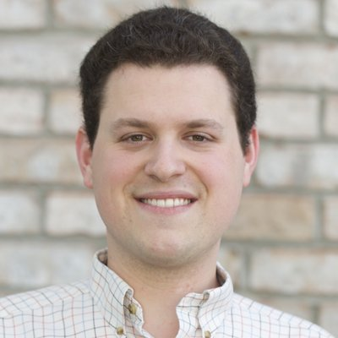
Swirl
Nick Carchedi, Johns Hopkins, 2013
Sean Kross, Johns Hopkins
“Learn R, in R”
Website: http://swirlstats.com/

Slide 24
Swirl
install.packages('swirl')
library(swirl)
swirl()

